Slide 1
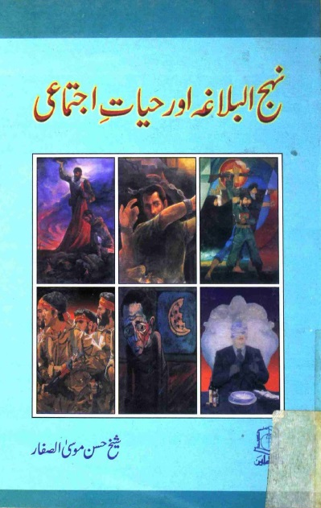
NEHJUL BALAGHA AUR HAYAT-E-IJTEMAAI
(Sheikh Hasan Musa Al Saffar)

Slide 2
INFORMATION ABOUT BOOK
Name : Nehjul Balagha aur Hayat-e-Ijtemaai
Compiled by : Hujjat-ul-Islam Sheikh Hasan Musa Al Saffar
Translated by : Syed Saeed Haider Zaidi
Publisher : Dar-us-Saqlain
Edition I: Moharram 1422 Hijri April 2001
Edition II: Shaban 1430 Hijri August 2009
Price : 60 Rs

Slide 3
CONTENT
Hayat-e-Imam Ali a.s
Nehjul Balagha Kya hai ?
Nehjul Balagha ki Ehmiyat
Aitrazat Kay Jawabat
Adalat e Ijtemaai
Muashray Mai Zulm Ki Mukhtalif Shaklain
Zulm Kay Muqabil Hamara Muaqqif Kya Hona Chahiye? (CONCLUSION)

Slide 4
IMAM A.S KI JAWANI KA DOUR
Haq o Haqeeqat Aur Jaded Afkar o Nazaryat Qabool Karnay Ki Salahiyyat
Islam Kay Khilaf Rasam o Riwaj Aur Andhi Taqleed Main Shadeed
Deen-e-islam Ki Qaboliat Say Muta’liq Sawal ?
Umat Kay Roshan Mustaqbil Kay Baray Mai Soch
Khud Etimadi Ki Misal
Jang-e-khandaq Ka Waqiya

Slide 5
KABAR SANI (Jawani) KA ZAMANA
Nehayat Danishmandana Andaz Say Qaaidana Kirdar Ada Karna
Islami Usoolon Ki Nashar o Isha’at Mai Masroof Rahay
Sahaba Kiram Ki Sabit Qadmi
DORAY AKHIR
Islam Kay Nizam e Adal e Ijtemaai Ki Be-Aib Tasveer Paish Karna
Talah, Zubair, Aur Muavia Bin Abi Sufyan Say Samjhota Na Karna

Slide 6
NEHJUL BALAGHA KYA HAI ?
Elahi Paigham Ki Nashar o Isha’at Aur Iska Nifaz
Logo Ki Bedari
Syed Razi (R.A) Ki Kawish
Nehjul Balagha Ka Mafhoom
Mola A.S Kay Adbi Pehlo Aur Balagat
Nehjul Balagha Mai Tamam Kalmat Shamil Nahi

Slide 7
NEHJUL BALAGHA KI EHMIYAT
Numaya Khusoosiyat
Ikhlaqi Usol, Jangi Qawaneen, Muashrati Nazm o Nasq, Siasat o Mua’ashrat
Iqtesad Kay Khutoot Ka Zikr Aur Unki Tashreeh o Tauzeeh
Tareekhi Hawadis Ki Muna’kis Aur Tamam Hawadis Ka Muqabla
Buland Adbi ,Zauq, Aur Balaghat Say Bharpoor

Slide 8
AETIRAZAT
Nehjul Balagha Mai Ghaib Ki Khabrain Di Gae Hain Jab Kay Hamara Aqeeda Hai Kay Khuda Kay Siwa Koi Aur Gaib Ka Ilm Nahi Rakhta ?
Surah Luqman Ka Hawala
Nehjul Balagha Khutba No. 126

Slide 9
ADALAT E IJTEMAAI
Adalat Ka Mafhoom
Adalat e Takweeni Kay Tehet Aadilana Muashray Ka Qayam
Zulm e Takweeni Say Zalimana Muashray Ki Bunyad
Aik Khaliq e Kainat Aur Us Ka Ata Karda Nizam
(Surah Mulk 67, ayat 2 – 3) Ka Hawala

Slide 10
MUASHRAY MAI ZULM KI MUKHTALIF SHAKLAIN
Fuqr o Mehroomi
“Aur Zameen Par Harkat Karnay Wali Koi Makhlooq Aisi Nahi Hai Jis Ka Rizq Khuda Kay Zimmay Na Ho”
(Surah Hood 11, Aayat No. 6)
Agr Dolat Mand Mohtajo Ki Madad Na Karay

Slide 11
MUASHRAY MAI ZULM KI MUKHTALIF SHAKLAIN
Tabqati Tafreeq
“Jidhar Chaho Logo Par Nigah Dorao, Tum Ye hi Dekho Gay Kay Aik Taraf Koi Faqeer Fuqur O Faqa Jhel Raha Hai, Aur Dosri Taraf Dolatmand Naimaton Ko Kufran e Naimat Se Badal Raha Hai”
(Nehjul Balagha – Khutba 127)

Slide 12
Ghumrahi Aur Jaraaim
“Aur Agar Ghani Apni Naikion Mai Bukhl Karay Ga Tou Faqeer Bhi Akhirat Ko Dunya Kay Ewaz Baichnay Par Amada Ho Jaey Ga”
(Nehjul Balagha Kalmatay Qisar 372)
Muashrati Bay Cheni Aur Bad Nazmi
“Aur Zulm o Sitam (Logo Ko) Talwar Uthanay Par Majboor Kar Day Ga “
(Nehjul Balagha Kalmat e Qisar 476)

Slide 13
Yaksaan Mawaqay Faraham Na Hona
Hukoomati Machinery Mai Tabdelian
Bhai Aqeel Bin Abi Talib Ki Darkhuwast Mustarad Karna
Qanoon Ki Girift Say Mehfooz Rehna
“Yad Rakho Kay Tumhara Zaleel Meri Nazar Mai Azeez Hai Jab Kay Mai Is Ka Haq Na Dilwa Do, Aur Tumhara Azeez Meri Nazar Mai Zaleel Mai Jab Tak Kay Is Say Dosro Ka Haq Na Wosool Karlo”
(Nehjul Balagha-khutba 37)

Slide 14
Zalim Kay Khilaf Mazloom Ka Sath Dena
Zulm Daikh Kar Gham Aur Dukh Ka Aisas Karna
(Akhri Wasiat)
“Zalim Kay Sar Sakht Dushman, Aur Mazloom Kay Monis o Madadgar Banna”
Zameer Mai Aik Kashmakash
Mout o Shahadat Ko Galay Lagana
CONCLUSION
(Nehjul Balagha – Khutba 3)
Adal Kay Qayam Aur Zulm Kay Khatmay Kay Liye Amli Jaddo Jehad

